Slide 1
AN EXPERIENCE OF
F.D FAN
FABRICATION

Slide 2
SEQUENCE OF THE PRESENTATION
Ground of the FD fan replacement
Theoretical weighting of the fan
Requirement of the air volume for combustion
Power consumption of the fan
Hurdles in fan fabrication
Performance of the fan
Learning

Slide 3
BOILERS UPGRADATION
To meet the power requirements of the plant, 2 X Boilers of 35T/h were upgraded to 45 T/h steam generation capacity. Capacity of boiler No: 1 FD fan was optimized by putting a new fan, whereas F.D fan of the boiler No:2 remains same, which gave problem to meet boiler’s enhanced capacity. The decision of replacement of the under capacity F.D fan was taken to cope the desired boiler capacity.

Slide 4
BOILER UP GRADATION STATUS of BOILER No: 2
S.NO | DESCRIPTION | Before | After
1 | Heating surface in M² | 947 | 1600
2 | I.D Fan capacity M³/min | 2520 | 3980
3 | F.D Fan capacity M³/min | 1300 | 1300
4 | Secondary Fan capacity M³/ min | 570 | 825

Slide 5
GROUNDS OF THE DECISION
Up graded boiler (35T/h to 45/T/h) was not meeting the desired MCR
Damping of bagasse in the furnace due to FD fan limitations
F.D fan was operated at maximum designed rpm, attaining only 37 Hertz frequency
The Fan blades were badly corroded.
The fan was not identical to the F.D fan of the same capacity boiler.

Slide 6
OXYGEN REQUIRED FOR BURNING OF BAGASSE
Air required to burn 1 kg bagasse is 4.45 M³
For 45 T/h boiler bagasse consumption per hour is approximately 22 T/h and the air required for combustion of bagasse is 1600 M³/min by volume.

Slide 7
AFFINITY LAW FOR THE FAN’S DIAMETER STATES THAT:
Q1 / Q2 = D1 / D2
1300 / 1600 = 1400 / D2
D2 = 1725

Slide 8
AFFINITY LAW OF FAN’S POWER STATES THAT:
P1 / P2 = (D1 / D2)³
110 / P2 = (1400 / 1700)³
P2 = 200 amp:

Slide 9
FABRICATION HURDULES
Marking of the fan
Fins curve not over lapped
Accuracy of the arc radius
Arc height justification
Length of the card

Slide 10
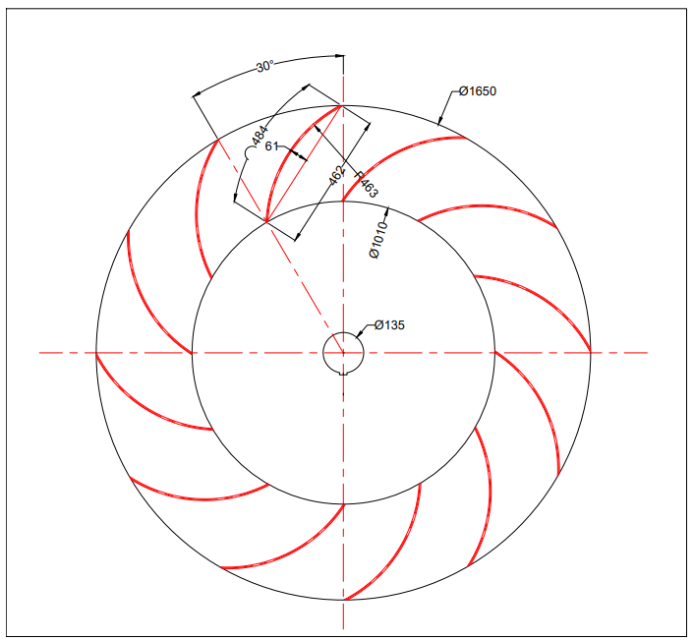
ɸ 1725
By simple distribution of blades over internal and external diameter the radius of the blades was not matching
The blades are not overlapping, indicating the mismatching blade profile

Slide 11
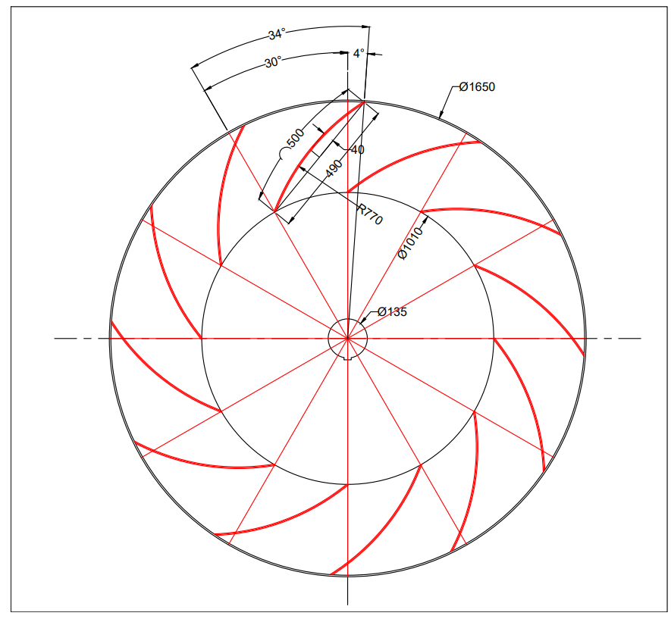
Radius 690mm
Arc Length 513mm
Arc Height 66mm
Card length 490mm
ɸ 1725
The angle of the blade arc extended by 4 degrees to attain the required blade overlap, the arc length was matching but the height of the arc was still not matching to the original blade’s height.
The formula of the arc height was appalied to get the desired arc height and it was right according to the original height of the blade.
R = C^2 + 4 H^2 / 8H

Slide 12
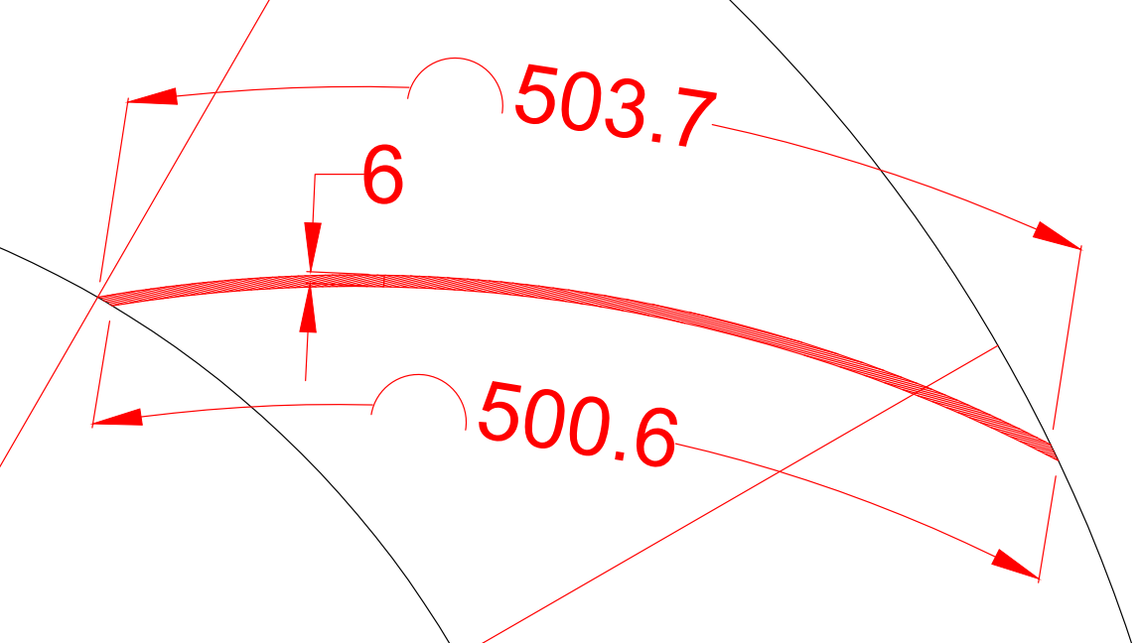

Slide 13
COMPARISON:
DESCRIPTION | OLD FAN | NEW FAN | REMARKS
Power in amperes | 110 Amp (132 kw) | 210 / 190 | 2 x undesired bands in the ducting
Fan diameter in mm | 1400 | 1725
Fan rpm | 1150 | 960
Frequency in hertz | 38 | 47
Quantity of air in M³/m | 1453 | 1615
Shaft diameter mm | 125 | 125

Slide 14
LEARNINGS
Copying means not only the summitry of the shape, it contains the complete resemblance of the theoretical aspects, design and performance

Slide 15
QUESTIONS?

